Slide 1
C2 Lab Environment Extension Plan
Johannes Castellano

Slide 2
Summary
Overview of each component (proxy, DNS, domain)
Justification for chosen solutions
Detailed setup and configuration plans
Diagram illustrating the extended lab environment
Discussion of security implications and mitigations

Slide 3
Overview of each component
Proxy
DNS
Domain

Slide 4
Justification for chosen solutions
Proxy: a combination of open-source proxy solutions will be implemented to provide a comprehensive testing ground for various C2 scenarios
DNS: Its robust feature set, extensive configurability, and wide adoption make it an ideal choice for simulating various DNS-related attacks and defenses
Domain: reputation, WHOIS obfuscation, costs

Slide 5
Detailed setup and configuration plans
Proxy
Squid
TOR
HAProxy
DNS
BIND9
Domain
Any provider from the List of Accredited Registrars by ICANN

Slide 6
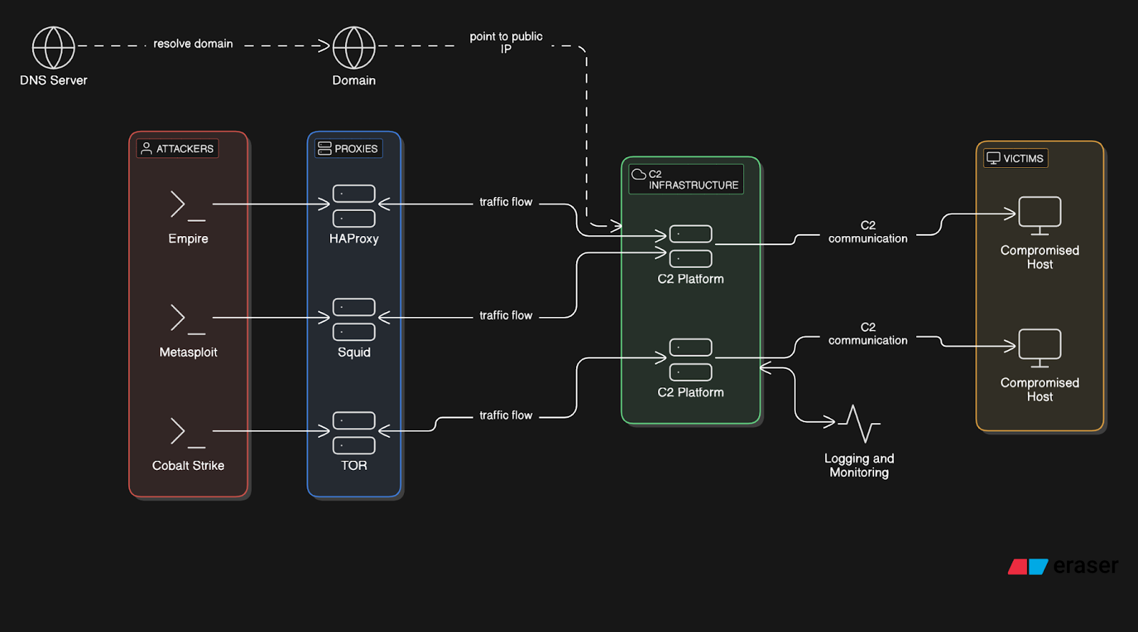
Diagram illustrating the extended lab environment

Slide 7
Discussion of security implications and mitigations
Proxy
Offensive: increases stealth and reduces the risk of detection and attribution
Defensive: Identifying the true source of malicious traffic becomes considerably more difficult
DNS
Offensive: covert communication channels that are often more difficult to detect
Defensive: Monitoring DNS query patterns for high entropy domains
Domain
WHOIS information and other details such as registration date can be used in investigation

